Slide 1

RUNGTA COLLEGE OF DENTAL SCIENCES & RESEARCH
TITLE OF THE TOPIC – TOOTH NOMENCLATURE
DEPARTMENT OF CONSERVATIVE DENTISTRY AND ENDODONTICS

Slide 2
Specific learning Objectives
At the end of this presentation the learner is expected to know ;
Core areas* | Domain ** | Category #
Different systems | Cognitive | Must know
Introduction | Cognitive | Must know
Categories | Cognitive | Must know
*Subtopic of importance
** Cognitive, Psychomotor or Affective
# Must know , Nice to know & Desire to know
( Table to be prepared as per the above format )

Slide 3
Content
• Types of Human Teeth
• Sets of Teeth
• Tooth Notation Systems
• Nomenclature of Tooth Surfaces
• Nomenclature Related to Dental Caries
• Nomenclature Related to Noncarious Defects of Teeth

Slide 4
For convenience human dentition is divided into four quadrants viz;
upper (maxillary) right,
upper (maxillary) left,
lower (mandibular) right and
lower (mandibular) left.
Right and left here relate to patient’s right and left side.

Slide 5
Why it is important to know anatomy of teeth?
It is important to understand anatomy of teeth because of following reasons:
For maintenance of supporting tissues in a healthy state .
For restoration of a damaged tooth to its original form.
For optimal function of teeth.

Slide 6
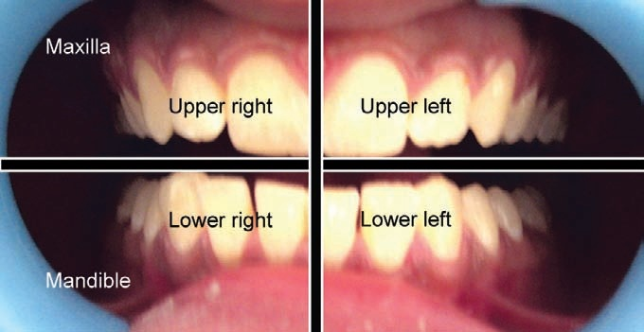
Division of whole dentition into four quadrants, i.e. upper right, upper left, lower right and lower left. Right and left relate to patient’s right and left

Slide 7
TOOTH NOTATION SYSTEMS
There are different tooth notations for identifying specific tooth.
The three most commons systems are
the “FDI World Dental Federation” notation,
the “Universal” system and
the “Zsigmondy-Palmer” system.
The FDI system is used worldwide and the universal is used predominantly in the USA.

Slide 8
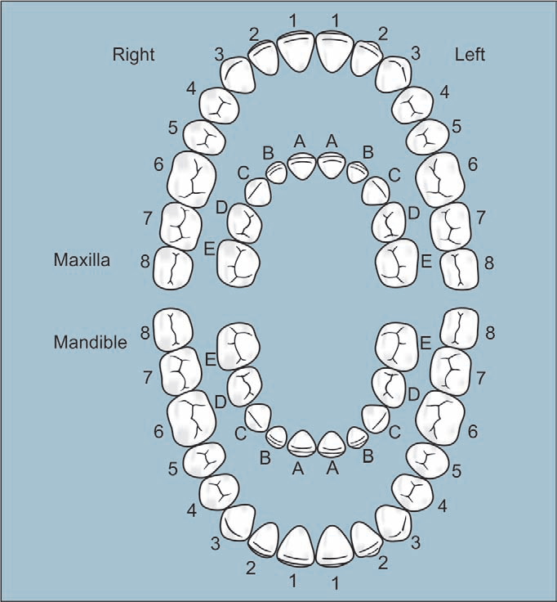
Zsigmondy-Palmer System
Introduced by ‘Zsigmondy’ in 1861
Each quadrant is designated by symbol ()
Permanent teeth are numbered 1 to 8
Primary teeth are indicated by A to E. Advantages
Simple and easy to use
Less chances of confusion between primary and permanent tooth as there is different notation, e.g. permanent teeth are described by numbers while primary teeth by alphabets.
Disadvantages
Difficulty in communication
Confusion between upper and lower quadrants, while communication and transferring a data.

Slide 9
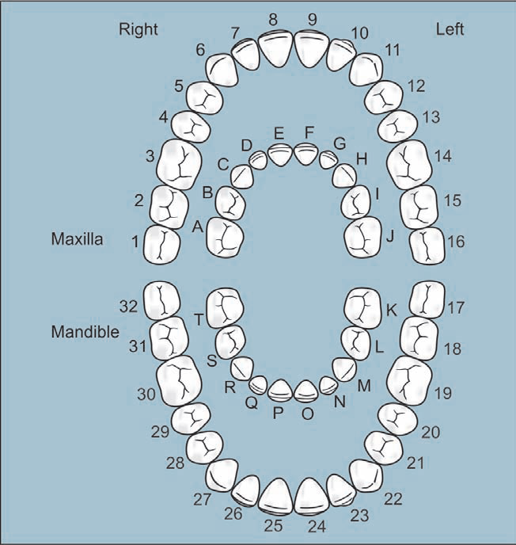
Universal (National) System
Use a unique number/letter for each tooth
Permanent teeth are numbered 1 to 32 starting from upper right molar
Deciduous teeth are designated as A to T, in this A is upper right second molar.
Advantages
Unique letter or number for each tooth avoiding confusions.
Disadvantages
Difficult to remember each letter or number of tooth.

Slide 10
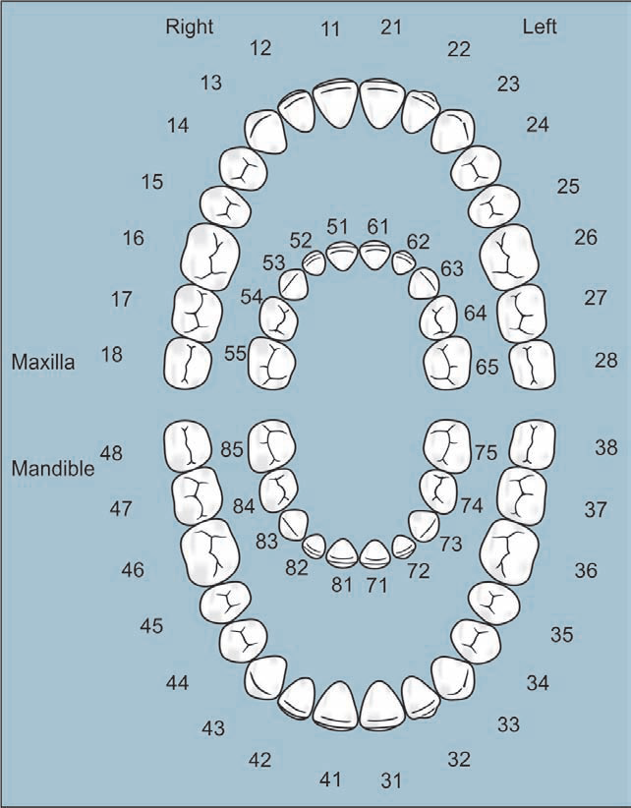
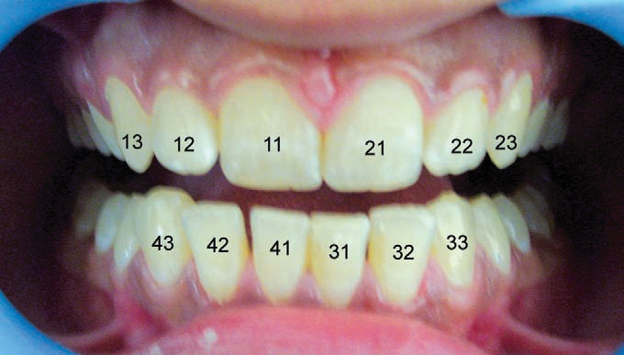
FDI World Dental Federation (Two-digit Notation)
Introduced in 1971
Also known as two-digit notation
In two digit system, first number represents tooth’s
quadrant while second number is the number of tooth from midline
Permanent upper right central incisor is designated as 11
Deciduous upper right central incisor is designated as 51.
Advantages
Simple to understand ,Simple to teach
Simple to pronounce
No confusion
Each tooth has specific number
Easy to record on computers
Easy for charting.
Disadvantage
May be confused with universal tooth numbering system.

Slide 11
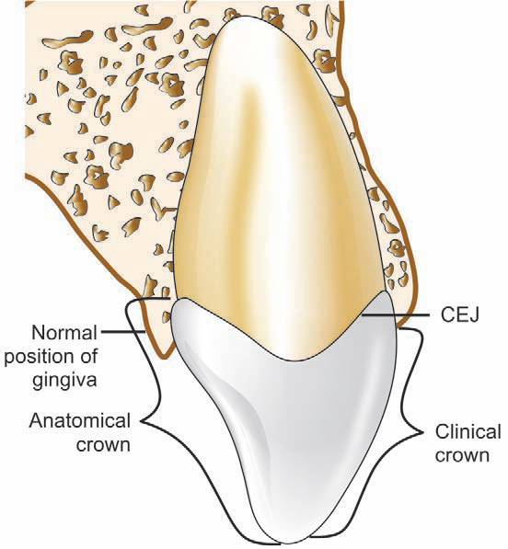
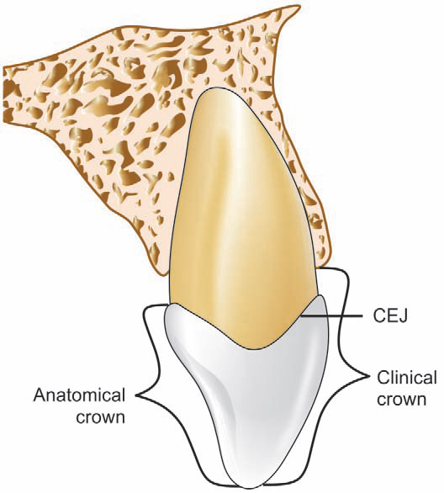
Anatomical crown and clinical crown
When there is gingival recession, clinical crown is
longer than anatomical crown

Slide 12
TAKE HOME MESSEGE/ FOR THE TOPIC COVERED (SUMMARY)
There are different tooth notations for identifying specific tooth.
The three most commons systems are
the “FDI World Dental Federation” notation,
the “Universal” system and
the “Zsigmondy-Palmer” system.
The FDI system is used worldwide and the universal is used predominantly in the USA.

Slide 13
Question & Answer Session
Zsigmondy Palmer system.
Universal tooth nomenclature.
Short note on FDI system of tooth nomenclature.

Slide 14
REFERENCES
NAME OF THE BOOK WITH EDITION AND PAGE NUMBERS
ARTICLE ARE TO BE MENTIONED IF NEEDED
Wheeler’s Dental Anatomy, Physiology and Occlusion- 10th Edition

Slide 15
THANK YOU

